Slide 1
4. Submitting SQL Statements to the DBMS
Using SQL in Microsoft SQL Server 2008
Before you can use SQL statements with Microsoft SQL Server, you need access to a computer that has SQL Server installed and that has a database with the tables and data shown in Figures 2-3, 2-4. Your instructor may have installed SQL Server in your computer lab and entered the data for you. If so, follow his or her instructions for accessing that database. Otherwise, you will need to obtain a copy of SQL Server 2008 R2 and install it on your computer. Read the appropriate sections of Chapter 10 about obtaining and installing SQL Server 2008.
After you have SQL Server 2008 R2 installed, you will need to read the introductory discussion for using SQL Server in Chapter 10, starting on page 373, and create the Cape Codd database. SQL Server scripts for creating and populating the Cape Codd database tables are available on our Web site at www.pearsonhighered.com/kroenke.

Slide 2
4. Submitting SQL Statements to the DBMS
Using SQL in Microsoft SQL Server 2008
SQL Server 2008 uses the Microsoft SQL Server 2008 R2 Management Studio as the GUI tool for managing the SQL Server DBMS and the databases controlled by the DBMS. The Microsoft SQL Server 2008 R2 Management Studio, which we will also refer to as just the SQL Server Management Studio, is installed as part of the SQL Server 2008 installation process and is discussed in Chapter 10. Figure 2-15 shows the execution of SQL-Query-CH02-01 (note that the SQL comment is not included in the SQL statement as run—also note that the SQL comment could have been included in the SQL code if we had chosen to include it):
/* *** SQL-Query-CH02-01 *** */
SELECT Department, Buyer
FROM SKU_DATA;

Slide 3
4. Submitting SQL Statements to the DBMS
Using SQL in Microsoft SQL Server 2008
Running an SQL Query in SQL Server Management Studio
Click the New Query button to display a new tabbed query window.
If the Cape Codd database is not displayed in the Available Database box, select it in the Available Databases drop-down list, and then click the Intellisense Enabled button to disable Intellisense.
in the query window, as shown in Figure 2-15.
Type the SQL SELECT command (without the SQL comment line shown above):
SELECT Department, Buyer
FROM SKU_DATA;

Slide 4
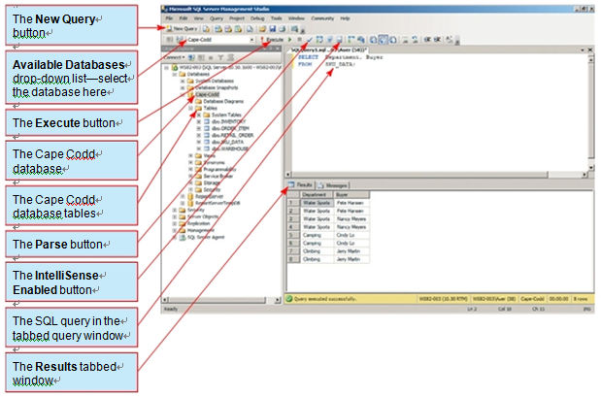
4. Submitting SQL Statements to the DBMS
Using SQL in Microsoft SQL Server 2008
Running an SQL Query in SQL Server Management Studio
Figure 2-15

Slide 5
4. Submitting SQL Statements to the DBMS
Using SQL in Microsoft SQL Server 2008
At this point you can check the SQL command syntax before actually running the
command by clicking the Parse button. A Results window will be displayed in the
same location shown in Figure 2-15, but with the message “Command(s) completed
successfully” if the SQL command syntax is correct or with an error message if there is a problem with the syntax.
Click the Execute button to run the query. The results are displayed in a results win-dow, as shown in Figure 2-15.
Note that in Figure 2-15 the Cape Codd database object in the Object Browser in the left side window of the SQL Server Management Studio has been expanded to show the tables in the Cape Codd database. Many of the functions of the SQL Server Management Studio are associated with the objects in the Object Browser and are often accessed by right-clicking the object to display a shortcut menu.

Slide 6
4. Submitting SQL Statements to the DBMS
Using SQL in Microsoft SQL Server 2008
By the way We are using SQL Server 2008 R2 Enterprise edition running in Microsoft
Server 2008 R2. When we give specific sequences of steps to follow in the
text or figures in this book, we use the command terminology used by SQL Server 2008
and associated utility programs in Microsoft Server 2008 R2. If you are running a
workstation operating system such as Microsoft XP or Microsoft Vista, the terminology
may vary somewhat.
SQL Server 2008 is an enterprise-class DBMS product, and, as is typical of such products, does not store queries within the DBMS (it does store SQL Views, which can be considered a type of query, and we will discuss SQL Views in this Chapter). However, you can save queries as SQL script files. An SQL script file is a separately stored plain text file, and it usually uses a file name extension of *.sql. An SQL script can be opened and run as an SQL command (or set of commands). Often used to create and populate databases, scripts can also be used to store a query or set of queries. Figure 2-16 shows the SQL query being saved as an SQL script.

Slide 7
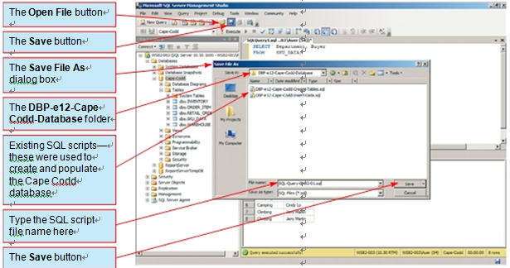
4. Submitting SQL Statements to the DBMS
Using SQL in Microsoft SQL Server 2008
Figure 2-16
Saving an SQL Query as an SQL Script in SQL Server Management Studio

Slide 8
4. Submitting SQL Statements to the DBMS
Using SQL in Microsoft SQL Server 2008
Note that in Figure 2-16 the SQL scripts are shown in a folder named DBP-e12-Cape-Codd-Database. When the Microsoft SQL Server 2008 Management Studio is installed, a new folder named SQL Server Management Studio is created in your My Documents folder, with Projects as a subfolder. The Projects folder is the default location used by SQL Server 2008 for SQL script files.
We recommend that you create a folder for each database in the Projects folder. We have created a folder named Cape-Codd-Database to store the script files associated with the Cape Codd database.

Slide 9
4. Submitting SQL Statements to the DBMS
Using SQL in Microsoft SQL Server 2008
Saving an SQL Server Query as an SQL Script in SQL Server Management Studio
1. Click the Save button shown in Figure 2-16. The Save File As dialog appears, as shown in Figure 2-16.
Browse to the My Documents\SQL Server Management Studio\Projects\DBP-
e12-Cape-Codd-Database folder.
3. Note that there are already two SQL script names displayed in the dialog box. These are the SQL scripts that were used to create and populate the Cape Codd database tables, and they are available on our Web site at www.pearsonhighered.com/kroenke.
4. In the File Name text box, type the SQL script file name SQL-Query-CH02-01.
5. Click the Save button.

Slide 10
4. Submitting SQL Statements to the DBMS
Using SQL in Microsoft SQL Server 2008
To rerun the saved query, you would click the Open File button shown in Figure 2-16 to open the Open File dialog box, open the query, and then click the Execute button.
At this point, you should work through each of the other nine queries in the preceding discussion of the SQL SELECT/FROM/WHERE framework. Save each query as SQL-Query-CH02-##, where ## is a sequential number from 02 to 09 that corresponds to the SQL query label shown in the SQL comment line of each query.

Slide 11
4. Submitting SQL Statements to the DBMS
Using SQL in Oracle Database 11g
Before you can enter SQL statements into Oracle Database 11g, you need access to a computer that has Oracle Database 11g installed and that has a database with the tables and data shown in Figure 2-4. Your instructor may have installed Oracle Database 11g on a computer in the lab and entered the data for you. If so, follow his or her instructions for accessing that database. Otherwise, you will need to obtain a copy of Oracle Database 11g and install it on your computer. Read the appropriate sections of Chapter 10A about obtaining and installing Oracle Database 11g.
After you have installed Oracle Database 11g, you will need to read the introductory discussion for Oracle Database 11g in Chapter 10A, starting on page 10A-1, and create the Cape Codd database. Oracle scripts for creating and populating the Cape Codd database tables are available on our Web site at www.pearsonhighered.com/kroenke.

Slide 12
4. Submitting SQL Statements to the DBMS
Using SQL in Oracle Database 11g
Although Oracle users have been dedicated to the Oracle SQL*Plus command line tool, professionals are moving to the new Oracle SQL Developer GUI tool. This application is installed as part of the Oracle Database 11g installation, and updated versions are available for free download at www.oracle.com/technology/software/products/sql/index.html. We will use it as our standard GUI tool for managing the databases created by the Oracle DBMS. Figure 2-17 shows the execution of SQL-Query-CH02-01 (note that the SQL comment is not included in the SQL statement as run—also note that the SQL comment could have been included in the SQL code if we had chosen to include it):
/* *** SQL-Query-CH02-01 *** */
SELECT Department, Buyer
FROM SKU_DATA;

Slide 13
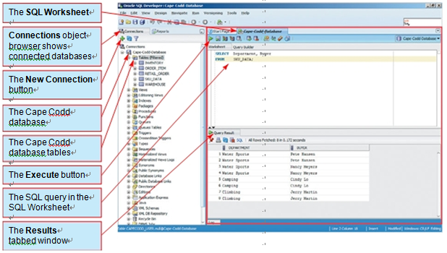
4. Submitting SQL Statements to the DBMS
Using SQL in Oracle Database 11g
Figure 2-17
Running an SQL Query in Oracle SQL Developer

Slide 14
4. Submitting SQL Statements to the DBMS
Using SQL in Oracle Database 11g
Running an SQL Query in Oracle SQL Developer
1. Click the New Connection button and open the Cape Codd database.
2. In the tabbed SQL Worksheet, type the SQL SELECT command (without the SQL
comment line shown above):
SELECT Department, Buyer
FROM SKU_DATA;
as shown in Figure 2-17.
3. Click the Execute button to run the query. The results are displayed in a results window, as shown in Figure 2-17.
Note that in Figure 2-17, the Cape Codd database object in the Object Browser in the left side Connection object browser of the Oracle SQL Developer has been expanded to show the tables in the Cape Codd database. Many of the functions of SQL Developer are associated with the objects in the Connections object browser and are often accessed by right-clicking the object to display a shortcut menu.

Slide 15
4. Submitting SQL Statements to the DBMS
Using SQL in Oracle Database 11g
By the way We are using Oracle Database 11g running in Microsoft Server 2008 R2.
When we give specific sequences of steps to follow in the text or figures in this book, we
use the command terminology used by Oracle Database 11g and associated utility programs
in Microsoft Server 2008. If you are running a workstationoperating system such as
Microsoft XP, Microsoft Vista, or Linux, the terminology may vary somewhat.
Oracle Database 11g is an enterprise-class DBMS product, and, as is typical of such
products, does not store queries within the DBMS (it does store SQL Views, which can be considered a type of query, and we will discuss SQL Views later in this chapter). However, you can save queries as SQL script files. An SQL script file is a separately stored plain text file, and it usually has a file name extension of *.sql. An SQL script can be opened and run as an SQL command (or set of commands). Often used to create and populate databases, scripts can also be used to store a query or set of queries. Figure 2-18 shows the SQL query being saved as an SQL script.

Slide 16
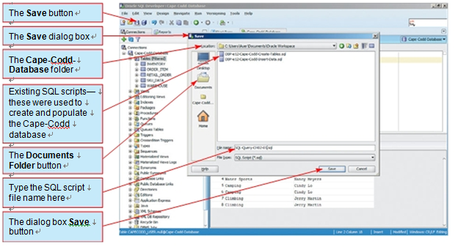
4. Submitting SQL Statements to the DBMS
Using SQL in Oracle Database 11g
Saving an Oracle SQL Query as an SQL Script in Oracle SQL Developer
Figure 2-18

Slide 17
4. Submitting SQL Statements to the DBMS
Using SQL in Oracle Database 11g
Note that in Figure 2-18 the SQL scripts are shown in a folder named {UserName}\
Documents\Oracle Workspace\DBP-e12-Cape-Codd-Database. By default, Oracle SQL Developer stores *.sql files in an obscure location within its own application files. We recommend that you create a subfolder in your My Documents folder named Oracle Workspace, and then create a subfolder for each database in the Oracle Workspace folder. We have created a folder named DBP-e12-Cape-Codd-Database store the script files associated with the Cape Codd database.

Slide 18
4. Submitting SQL Statements to the DBMS
Using SQL in Oracle Database 11g
Saving an SQL Script in Oracle SQL Developer
Click the Save button shown in Figure 2-18. The Save dialog appears, as shown in
Figure 2-18.
2. Click the Documents button on the Save dialog box to move to the Documents
folder, and then browse to the DBP-e12-Cape-Codd-Database folder.
3. Note that there are already two SQL script names displayed in the dialog box.
These are the SQL scripts that were used to create and populate the Cape Codd
database tables, and they are available on our Web site at www.pearsonhighered.
com/kroenke.
4. In the File Name text box, type the SQL script file name SQL-Query-CH02-01.sql.
Click the Save button.

Slide 19
4. Submitting SQL Statements to the DBMS
Using SQL in Oracle Database 11g
To rerun the saved query, you would click the SQL Developer Open File button to open the Open File dialog box, browse to the query file, open the query file, and then click the Execute button.
At this point, you should work through each of the other nine queries in the preceding discussion of the SQL SELECT/FROM/WHERE framework. Save each query as SQLQuery-CH02-##, where ## is a sequential number from 02 to 09 that corresponds to the SQL query label shown in the SQL comment line of each query.

Slide 20
4. Submitting SQL Statements to the DBMS
Using SQL in Oracle MySQL 5.5
Before you can use SQL statements with Oracle MySQL 5.5, you need access to a computer that has MySQL installed and that has a database with the tables and data shown in Figure 2-4. Your instructor may have installed MySQL in your computer lab and entered the data for you. If so, follow his or her instructions for accessing that database. Otherwise, you will need to obtain a copy of MySQL Server 5.5 and install it on your computer. Read the appropriate sections of Chapter 10B about obtaining and installing MySQL Community Server 5.5.
After you have MySQL Sever 5.5 installed, you will need to read the introductory discussion for MySQL Server 5.5 in Chapter 10B, starting on page 10 B-448, and create the Cape Codd database. MySQL scripts for creating and populating the Cape Codd database tables are available on our Web site at www.pearsonhighered.com/kroenke.

Slide 21
4. Submitting SQL Statements to the DBMS
Using SQL in Oracle MySQL 5.5
MySQL uses two tools,the MySQL Administrator and the MySQL Query Browser, as the GUI tools for managing the MySQL DBMS and the databases controlled by the DBMS. These tools must be installed separately from the MySQL DBMS, and this is discussed in Chapter 10B. SQL statements are created and run in the MySQL Query Browser, and Figure 2-19 shows the execution of the SQL statement:
/* *** SQL-Query-CH02-01 *** */
SELECT Department, Buyer
FROM SKU_DATA;

Slide 22
4. Submitting SQL Statements to the DBMS
Using SQL in Oracle MySQL 5.5
Running an SQL Query in the MySQL Workbench
1. To make the Cape Codd database the default schema (active database), right-click
the cape_codd schema (database) object to display the shortcut menu and then
click the Set as Default Schema command.
2. In the Query 1 tabbed window in the SQL Editor tabbed window, type the SQL
SELECT command (without the SQL comment line shown above):
SELECT Department, Buyer
FROM SKU_DATA;
as shown in Figure 2-19.
3. Click the Execute Current SQL Statement in Connected Server button to run the
query. The results are displayed in a tabbed Query Result window, shown as the Query 1 Result window in Figure 2-19.

Slide 23
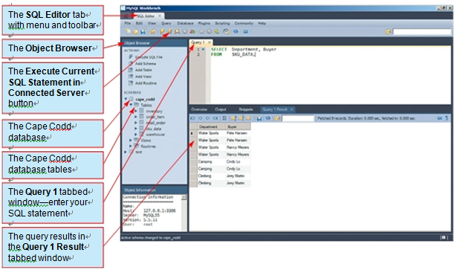
4. Submitting SQL Statements to the DBMS
Using SQL in Oracle MySQL 5.5
Running an SQL Query in the MySQL Workbench
Figure 2-19

Slide 24
4. Submitting SQL Statements to the DBMS
Using SQL in Oracle MySQL 5.5
Note that in Figure 2-19 the Cape Codd database object in the Object Browser in the left-side window of the MySQL Workbench has been expanded to show the tables in the Cape Codd database. Many of the functions of the MySQL Workbench are associated with the objects in the Object Browser and are often accessed by right-clicking the object to display a shortcut menu.
By the way We are using MySQL 5.5 Community Server running in Microsoft Server
2008 . When we give specific sequences of steps to follow in the text
or figures in this book, we use the command terminology used for MySQL 5.5 and asso-
ciated utility programs in Microsoft Server 2008 R2. If you are running a workstation
operating system such as Microsoft XP, Microsoft Vista, or Linux, the terminology may
vary somewhat.

Slide 25
4. Submitting SQL Statements to the DBMS
Using SQL in Oracle MySQL 5.5
MySQL 5.5 is an enterprise-class DBMS product, and, as is typical of such products, does not store queries within the DBMS (it does store SQL Views, which can be considered a type of query, and we will discuss SQL Views later in this chapter). However, you can save MySQL queries as SQL script files. An SQL script file is a separately stored plain text file, and it usually uses a file name extension of *.sql. An SQL script file can be opened and run as an SQLcommand. Figure 2-20shows the SQL query being saved as an SQL script file.
Note that in Figure 2-20 the query will be saved in a folder named My Documents\MySQL Workspace\Schemas\DBP-e12-Cape-Codd-Database. By default, MySQL Workbench storesfiles in the user’s My Documents folder. We recommend that you create a subfolder in your My Documents folder named MySQL Workspace, and then create subfolders labeled EER Models and Schemas. Within each of these subfolders, create a sub-subfolder for each MySQL database. We have created a folder named DBP-e12-Cape-Code-Database to store the script files associated with the Cape Codd database.

Slide 26
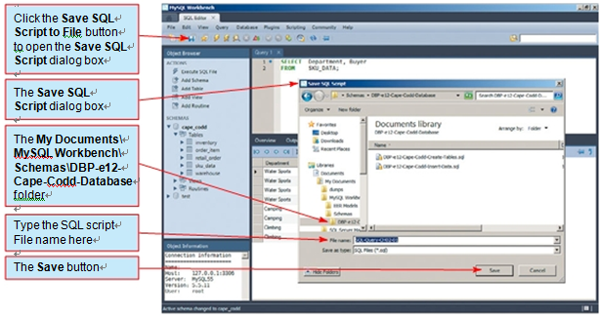
4. Submitting SQL Statements to the DBMS
Processing SQL Statements in Microsoft Access 2010
Figure 2-20
Saving an SQL Query as an SQL Script in the MySQL Workbench

Slide 27
4. Submitting SQL Statements to the DBMS
Using SQL in Oracle MySQL 5.5
Saving a MySQL Query
1. Use the File | Save as command, as shown in Figure 2-20. The Save Query to File dialog appears, as shown in Figure 2-20.
2. Browse to the My Documents\MySQL Workspace\Schemas\DBP-e12-Cape-Codd-
Database folder.
3. In the File Name text box, type the SQL query file name SQL-Query-CH02-01.
4. Click the Save button.
To rerun the saved query, you would click the File | Open SQL Script menu command to open the Open SQL Script dialog box, then select and open the SQL query *.sql files, and, finally, click the Execute Current SQL Statement in Connected Server button.
At this point, you should work through each of the other nine queries in the preceding discussion of the SQL SELECT/FROM/WHERE framework. Save each query as SQLQueryCH02-##, where ## is a sequential number from 02 to 09 that corresponds to the SQL query label shown in the SQL comment line of each query.

Slide 28
Thank You!
LOGO

